Slide 1
COVID-19 Prevention Glove Use
In The Workplace

Slide 2
Purpose
This guide aims to help employees understand when and how to use protective gloves in the workplace and associated with conducting disinfection procedures and providing protection from COVID-19 infections.
Please Note: The information in this guide does not address glove use associated with medical or dental procedures.

Slide 3
Guide Overview
1
Glove requirements associated with COVID-19 prevention in the workplace
2
Other glove use recommendations and options
3
Proper glove use
4
Remove jewelry before using gloves
5
Clean hands before using gloves
6
Putting gloves on
7
Taking gloves off
8
Other glove use requirements and awareness
9
Only use provided gloves
10
Irritant contact dermatitis from glove use

Slide 4
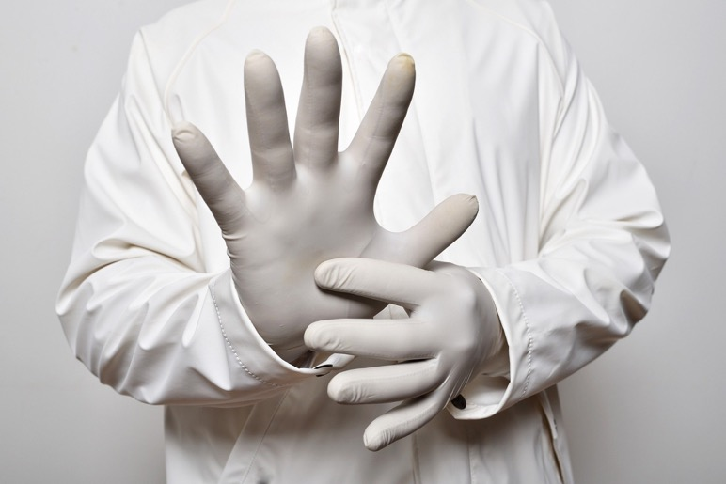
1. Glove requirements associated with COVID-19 prevention in the workplace
Gloves are required for use by employees performing disinfection procedures to prevent skin contact with disinfectant products and significant potential contact with contaminated surfaces while performing cleaning and disinfection.
When using gloves for disinfection, it is important that the glove material be compatible with the disinfectant being used to prevent exposure.
See your site EHS support or supervisor for assistance if needed.

Slide 5
2. Other glove use recommendations and options
Employees with an open wound on their hand may benefit from the use of gloves to minimize the potential for COVID-19 infection and are encouraged to use gloves safely until the open wounds where the skin is not intact is healed.
Gloves will be provided for any employee who wants to use them, however it is important to understand and carefully consider the requirements, limitations and potential hazards associated with their long-term use.

Slide 6
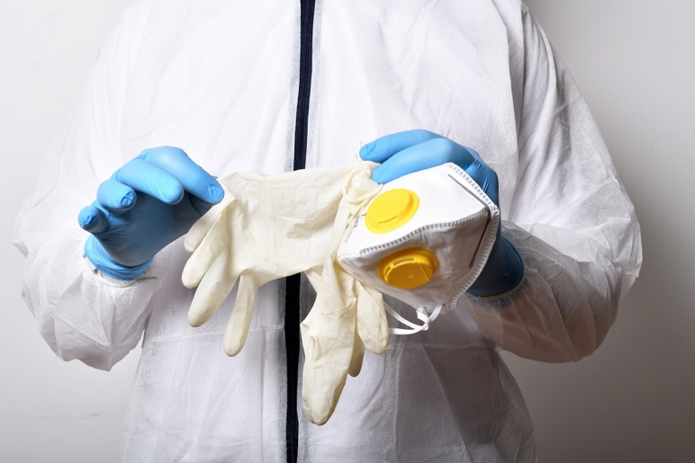
3. Proper glove use
Make sure you have the proper size of gloves for your hands.
Gloves that are too large may present workplace hazards and difficulty when completing tasks.
Gloves that are too tight can cause irritation to the skin, restrict blood flow to the hands and are more easily ripped or punctured.

Slide 7
4. Remove jewelry before using gloves
Remove and securely store rings or other jewelry on your hands or wrists before washing your hands to prepare for glove use.
Keep in mind that jewelry can cause the gloves to tear or puncture, and can present other hazards in the work environment.

Slide 8
5. Clean hands before using gloves
Wash your hands with soap and water properly before using gloves, and ensure your hands are thoroughly dried using a clean towel before putting the gloves on your hands.
Using soap and water to wash hands before wearing gloves is preferred to using hand sanitizer.

Slide 9
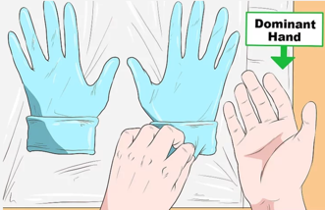
6. Putting gloves on
1
2
3
Roll up the open end of each glove and place the first glove on your dominant hand.
Slide the second glove on your other hand and adjust the gloves for a comfortable fit.
Visually check your gloves for tears or punctures..

Slide 10
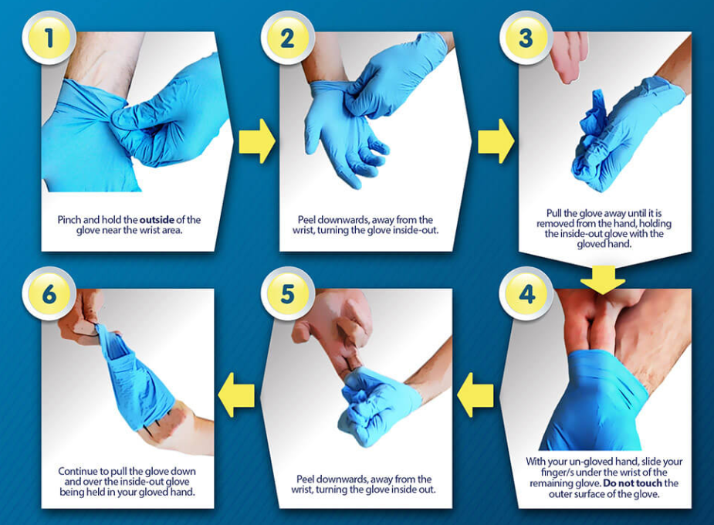
7. Taking gloves off
Follow the process outlined at right, and then immediately discard the used gloves in a trash receptacle.

Slide 11
8. Other glove use requirements and awareness
9. Only use gloves provided
10. Irritant contact dermatitis from glove use
Be aware that sharp objects can puncture gloves.
Always change your gloves if they rip or tear.
After removing gloves, wash your hands thoroughly with soap and water or use an alcohol-based hand rub.
Never reuse gloves.
Never wash or disinfect gloves.
Never share gloves with others.
Only use the gloves provided for use at your site.
Some people are allergic to the natural rubber latex that can be present in some gloves.
The gloves provided at your site will be nitrile or vinyl, and they will not contain natural latex.
If you experience a rash, irritation or itching on your hands, please remove the gloves and discuss with your site EHS support or supervisor.
Irritant contact dermatitis can result from repeated and prolonged glove use in some people.
Contact dermatitis is non-allergenic and develops as dry, itchy, irritated areas on the skin around the area of contact. It is usually caused by an irritant, such as the chemicals commonly used in the manufacture of hand products and gloves.
If you are using gloves in the workplace and develop dry, itchy or irritated areas on your hands, please see your EHS support or supervisor.

