Slide 1
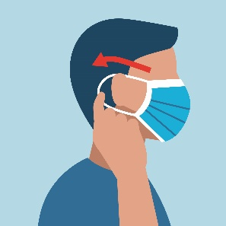
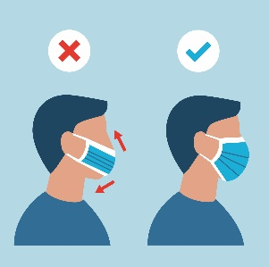
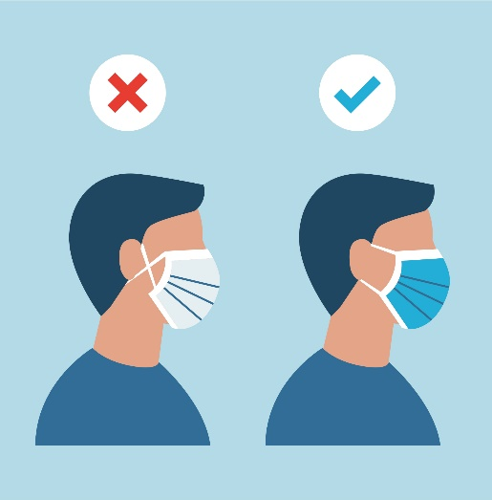
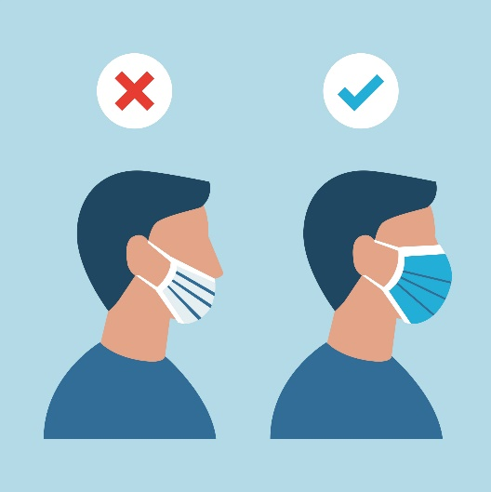
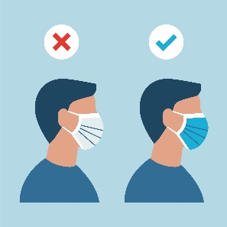
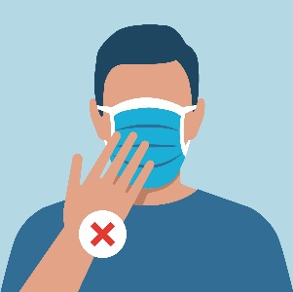
HOW TO WEAR A SURGICAL MASK
INSTRUCTION FOR USE
Improper use
1. Perform hand hygiene before donning mask.
2. Holding mask by ear loops, place loops around each ear.
3. Pull top and base of mask over mouth and chin. Mold malleable strip at the top edge of mask to shape of nose.
1. Do not criss-cross the ear loop before wrapping it around each ear. This may create gaps allowing particles to enter.
2. Ensure the mask covers both the nose and mouth
4. Ensure the proper side of the mask faces outwards.
5. Do not touch the outside of the mask as it may be contaminated.
Notes:
WHO Quote: https://www.who.int/emergencies/diseases/novel-coronavirus-2019/question-and-answers-hub/q-a-detail/q-a-on-covid-19-and-masks
Source: CDC Interim Infection Prevention and Control Guidance for Dental Settings During the COVID-19 Response
https://www.cdc.gov/coronavirus/2019-ncov/hcp/dental-settings.html#PPE

Slide 2
HOW TO WEAR A SURGICAL MASK
RECOMMENDATIONS
Low Barrier | Moderate Barrier | High Barrier
Physical Barrier only | Moderate fluid Resistance | High Fluid Resistance
ASTM Level 1/ Type I | ASTM Level 2/ Type II | ASTM Level 3/Type IIR
Clinical use: exams, short procedures that do not involve fluids, sprays or aerosols. | Clinical use: light to moderate amounts of spray and/or aerosols produced. | Clinical use: Moderate to heavy amounts of fluid, spray and/or aerosols produced.
No filtration efficiency | Will filter bacteria>98% Will filter particles>98% 0.1 micron | Will filter 98% of bacteria and particles 0.1 micron
WHO
Medical masks are recommended in health care settings. However, it is important to remember that the use of masks should be combined with other key infection prevention and control measures such as hand hygiene and physical distancing, as they do not serve all purposes to protect against COVID-19*
*https://www.who.int/emergencies/diseases/novel-coronavirus-2019/question-and-answers-hub/q-a-detail/q-a-on-covid-19-and-masks
CDC
“Dental Health Care Professionals should wear a surgical mask, eye protection (goggles, protective eyewear with solid side shields, or a full-face shield), and a gown or protective clothing during procedures likely to generate splashing or spattering of blood or other body fluids.*
*CDC Interim Infection Prevention and Control Guidance for Dental Settings During the COVID-19 Response
https://www.cdc.gov/coronavirus/2019-ncov/hcp/dental-settings.html#PPE
If a respirator is not available for an aerosol-generating procedure, use both a surgical mask and a full-face shield. Ensure that the mask is cleared by the US Food and Drug Administration (FDA) as a surgical mask (https://www.cdc.gov/niosh/npptl/topics/respirators/disp_part/n95list1sect2-m.html). Use the highest level of surgical mask available. If a surgical mask and a full-face shield are not available, do not perform any aerosol-generating procedures.
Local/Regional Regulations
Users should consult their local regulations and requirements or check their local public health authorities
Notes:
WHO Quote: https://www.who.int/emergencies/diseases/novel-coronavirus-2019/question-and-answers-hub/q-a-detail/q-a-on-covid-19-and-masks
Source: CDC Interim Infection Prevention and Control Guidance for Dental Settings During the COVID-19 Response
https://www.cdc.gov/coronavirus/2019-ncov/hcp/dental-settings.html#PPE

Slide 3
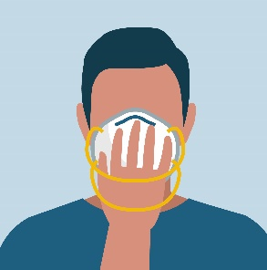
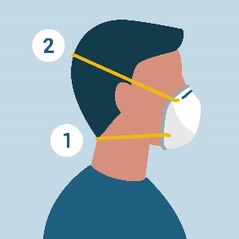
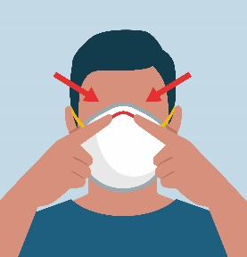
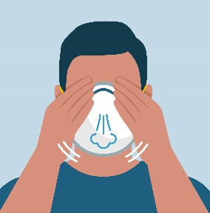
HOW TO WEAR A RESPIRATOR MASK
INSTRUCTION FOR USE
RECOMMENDATIONS
Filtering Facepiece Respirators
High Fluid Resistance
N95, FFP2, P2, DS2, Korea 1st class, KN95
Use when treating patients with airborne diseases such as TB or Influenza
Depending on performance standards by country, required to filtrate > 94% or > 95% of very small (0.1 micron) test particles, some achieve 99.9%
1. Wash your hands.
2. Hold the mask in your hand and place it on nose, mouth and chin.
3. Position the bottom strap under your ears and the top strap at the back of your head.
WHO
“Use a particulate respirator at least as a protective as a NIOSH certified N95, European Union standard FFP2, or equivalent, when performing or working in settings where aerosols-generating procedures” *
* https://www.who.int/emergencies/diseases/novel-coronavirus-2019/question-and-answers-hub/q-a-detail/q-a-on-covid-19-and-masks
CDC
“During aerosol-generating procedures conducted on patients assumed to be non-contagious, consider the use of an N95 respirator (https://www.cdc.gov/niosh/npptl/topics/respirators/disp_part/n95list1sect2-m.html)
or a respirator that offers a higher level of protection such as other disposable filtering facepiece respirators, PAPRs, elastomeric respirators, if available” *
* https://www.cdc.gov/coronavirus/2019-ncov/hcp/dental-settings.html#PPE
Where applicable:
Review and/or establish the facilities Respiratory Protection Program (RPP). The program should be comprehensive, written, fit testing (initial fit test is required, yet annual fit testing is waived at this time), training, medical exam and seal test, as per Occupation Safety and Health Administration (OSHA) standard 1910.134 - Respiratory Protection. https://www.osha.gov/SLTC/respiratoryprotection/
Fit Testing and annual training in the use, maintenance, and care are required prior to respirator use.
https://www.osha.gov/SLTC/respiratoryprotection/
Local/Regional Regulations
Prior to selecting a respirator, users should consult their local respiratory protection regulations and requirements or check their local public health authorities for selection guidance
4. Press the metallic wire to fit the shape of your nose and face.
5. Perfom a user seal check: place hands over the respirator and exhale, adjust if there are leaks.
Notes:
WHO Quote: https://www.who.int/emergencies/diseases/novel-coronavirus-2019/question-and-answers-hub/q-a-detail/q-a-on-covid-19-and-masks
CDC Quote: https://www.cdc.gov/coronavirus/2019-ncov/hcp/dental-settings.html#PPE

